Slide 1
Effect of Taxation on Income inequality and Public Welfare
Presented By:
Mirza Kashif
Abdul Rehman
Jehanzeb Shahzad
Muhammad Usman
Zain Khan

Slide 2
Introduction
Progressive income taxes, when considered separately, positively impact income distribution.
Contributing to decreasing inequality, and this effect is more pronounced the higher the degree of progressivity and the higher the share of GDP
In terms of the magnitude of the impact, the effects of taxes on income distribution changes tend to be of an equivalent scale to those for public expenditures.

Slide 3
Introduction
Income inequality has increased sharply over the past 40 years.
Taxation with negative net tax rates for the poorest households can be used to achieve two goals
  providing a minimal level of consumption for the poor
  reducing income disparity between different sectors of the population
The ultimate policy instrument for reducing income disparity is income taxation (Henry & Maniquet, 2021)
Full income equality is not a legitimate objective (Mirrlees, 1971)

Slide 4
Literature Review
Most of the empirical studies on tax incidence are country-specific studies relying on microsimulation models and computable general equilibrium models.
The general conclusion reached in this literature is that the redistributive effects of taxes are weak, especially so for developing countries. (Bird and Zolt, 2005; Harberger, 2006; and Martinez-Vazquez, 2008).
While progressivity reduces observed inequality in reported gross and net income, it has a significantly smaller impact on “true inequality. (Duncan and Sabirianova Peter, 2008)
321 billion cash benefits to households with low income in UK (07-08)
Higgins et. Al 2016 claimed that 25% Poor paid more taxes than they received transfers

Slide 5
Literature Review
Cyan et. Al 2016 Pakistan showed that groups with lower labor force participation paid more taxes as compared to those with higher participation
Quatrebarbes 2016 claimed VAT should vary in different economic sectors expect on staple food
Inequalities in income reflect differences in worker productivity which ultimately leads to income inequality (Mirrlees, et al, 2001)
Seemingly equivalent workers have significant income disparities too (Kerney, et al, 2008)

Slide 6
Methodology
Carried out a survey with 21 participants
Peer reviewed articles finding for our research
Notes:
Journanl of public economics
Europian Journal of political economics
Thw wconomic journal
Journal of macro economics

Slide 7
Income inequality
Inequality is the state of not being equal especially in rights, opportunities and status
4 types of inequality
  inequality of outcome
  inequality of wealth
  inequality over a particular individual’s lifetime
  income inequality of opportunity
To quantify income inequality, economists use Gini index/Lorenz curve
0.55 represents a high level of inequality, 0,45-0.55 represents middle high, 0.35-0.45 represents middle and a value lower than 0.35 represents a low level of inequality
Notes:
GINI Coefficient Difference b/w 45 degree line and Lorenz curve

Slide 8
Findings
Taxes and transfers have a significant redistributive impact
Inequality in income after taxes and transfers, measured by Gini index, was 25% lower than for income before taxes and transfers on average in the OECD area (Joumard, Pisu & Bloch, 2012)
For the same period, poverty measured after taxes and transfers was 55% lower than before taxes and transfers for the OECD (Joumard, Pisu & Bloch, 2012)
Cash transfers reduce income dispersion more than taxes

Slide 9
Optimal Tax Approach
Standard approach to optimal taxation is based on several methodological assumptions:
  government must raise a certain amount of revenue
  limited in the types of tax instruments it can use
  decisions must be consistent with individual and firm optimization
  makes its decisions in order to maximize a "social welfare function"

Slide 10
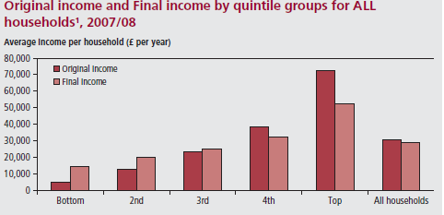
Income Distribution and Taxes among different level of Households
Notes:
The bottom has 4700 Pound after taxes and benefits but on the other hand for Top there is 52400 final income per year when compared with bottom it has 14300 Pound which is approximately 3 to 4 times larger

Slide 11
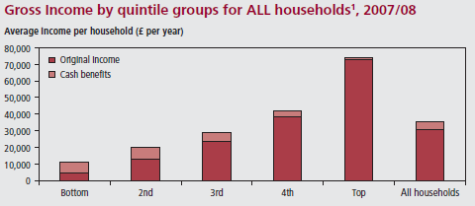
Notes:
Majority Cash Benefits go to the households with little income like it can be seen in the above graph to Bottom and 2nd Quintile group in 07-08 for all households

Slide 12
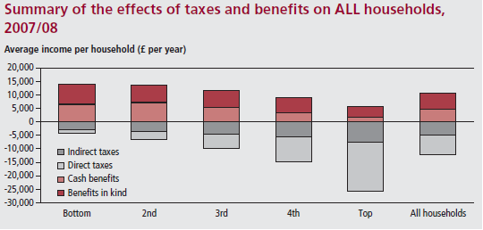
Notes:
The Above Table shows that Direct Taxes are taken at most from the Top Households and they are given the least cash benefit but on the other hand Bottom and 2nd Quintiles are charged the least Direct Tax but maximum Indirect Taxes and with maximum Cash benefit and benefits in kind given too.

Slide 13
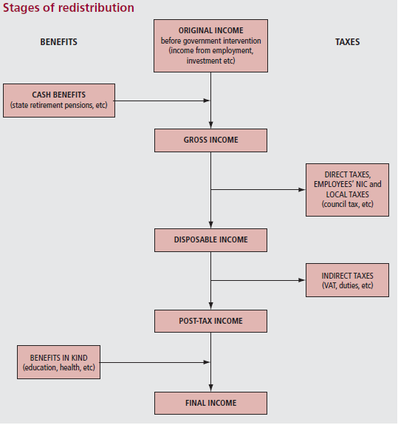
Notes:
The above graph shows The Stages of Redistribution a product passes from when moving to the final income of an individual or household.

Slide 14
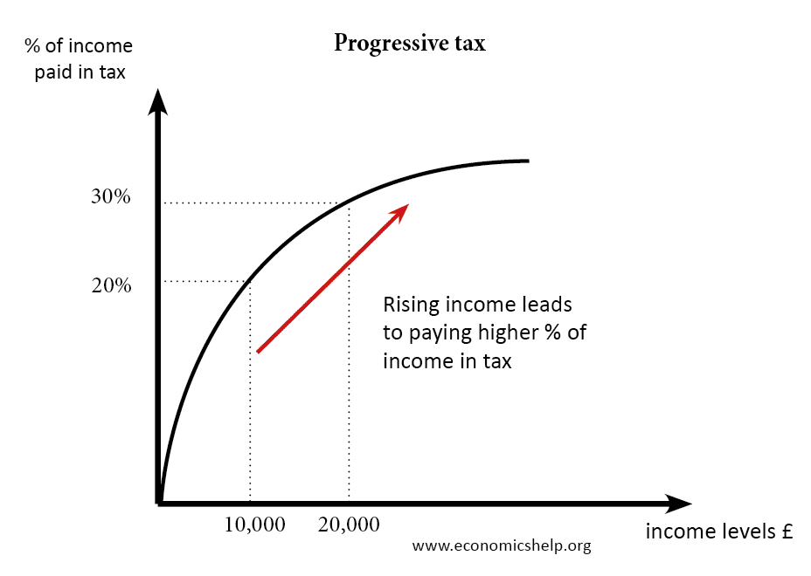
Progressive Taxation
A progressive tax is one where individuals with higher taxable incomes pay progressively higher proportions of their income in tax (Woolard, Metz, Inchauste, Lustig, Maboshe, & Purfield, 2015).

Slide 15
Progressive Taxation
Benefits
Progressive taxation leads to social justice.
Oishi et al. (2018) analyzed the effect of progressive taxation on income inequality and happiness of Americans
  Their results indicated that income inequality was significantly smaller in the periods when the income tax was more progressive.
Progressive Taxation acts as automatic stabilizer
Limitations
Tax Evasion
  The evasion may increase actual disposable income of the rich and therefore increase inequality in actual net income.
In earlier studies, that the evasion effect is much stronger in the high-income bracket of the income distribution (Slemrod, 1994; Feldstein, 1995).
The rich tend to be more sensitive to changes in the tax rates because they are better able to hide their income.

Slide 16
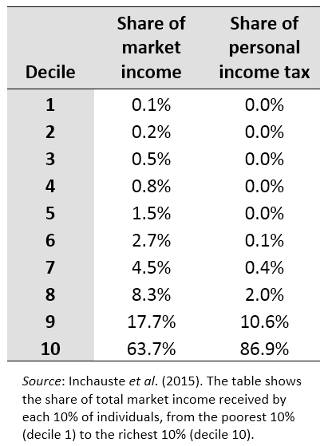
Distribution of market income and personal income tax contributions
Notes:
the wealthiest 10% of individuals earn about 63.7% of total market income, but they pay 86.9% of total personal income tax.
South Africa 2015

Slide 17
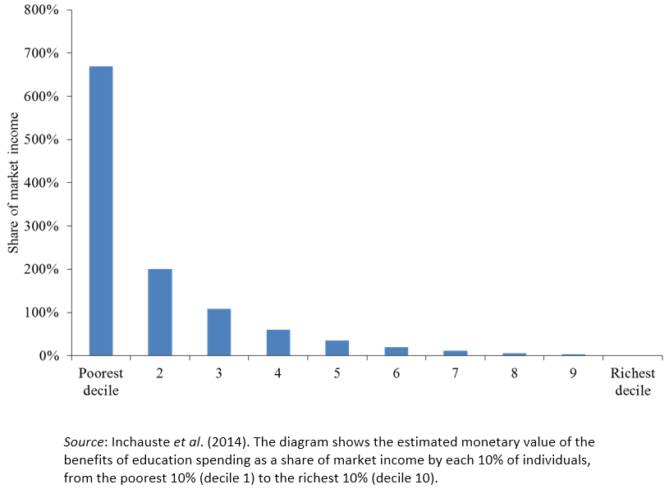
Incidence of education spending
Notes:
how the poorest households comparatively receive much more benefit from spending on education than their share of market income.

Slide 18
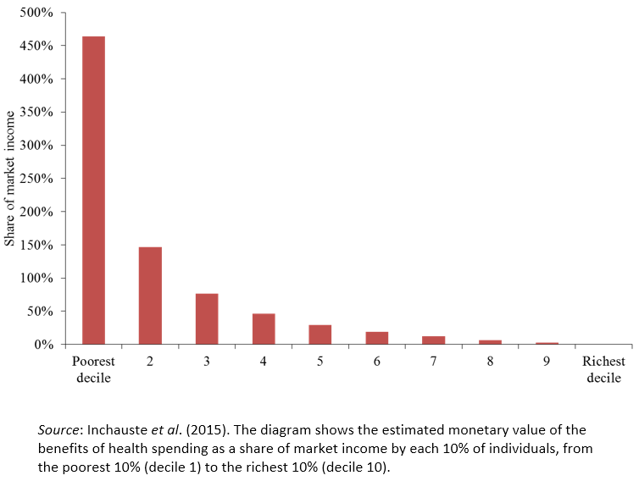
Incidence of health spending
Notes:
how the poorest households comparatively receive much more benefit from health spending than their share of market income.

Slide 19
Incompetence of Government
difference between a developed nation and developing nation is the efficacy of government – Macroeconomic laws
drop their parental role perhaps because they lack the financial resources to do so (Ibadin & Oladipupo, 2015)
provision of merit and de merit goods, a stable exchange rate, economic growth, income equality, less unemployment and fairness
Source of revenue - Taxes

Slide 20
Transfer Payments
Governments have been adamant in improving social welfare
Transfer payments are detrimental to income disparity - impossible to sustain so far into existence
Rewarding people for incompetence in a capitalist society
Prolong the inevitable – income disparity
Transfer payments yield no return in the long run
An efficient tax system – only solution to disparity- Action Aid (2013)

Slide 21
Findings
Value Added Tax increases income inequality, which is the Gini coefficient so it is positively correlated with income inequality
Indirect taxes are regressive - excluding a particular group is impossible
Petroleum Profit Tax (PPT) increases income inequality
Taxes on necessities such as petrol always end up in cost push inflation
Corporate Income Taxes in fact decrease income disparity
Easy to exclude certain groups

Slide 22
The interaction of taxes and public spending and income distribution
Tax-benefit systems have become more redistributive since the 1980s.
The trend has not been large enough to offset the increasing trend in market-income inequality which grew by twice as much as redistribution.
In terms of redistribution strength, direct “benefits” had a much stronger impact on redistribution than personal income taxes and social security contributions, despite the much larger relative size of these taxes in GDP.

Slide 23
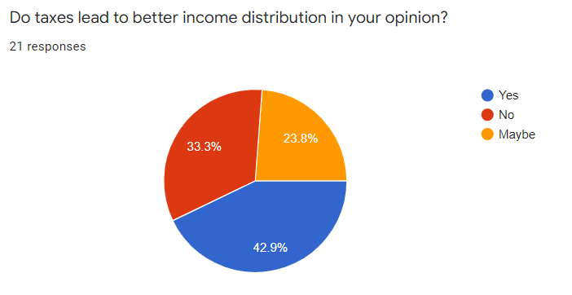
Notes:
Cash benefit gives 44% of gross income to the low income earners and 1% to high income earners
GST negatively impact the purchasing power of people

Slide 24
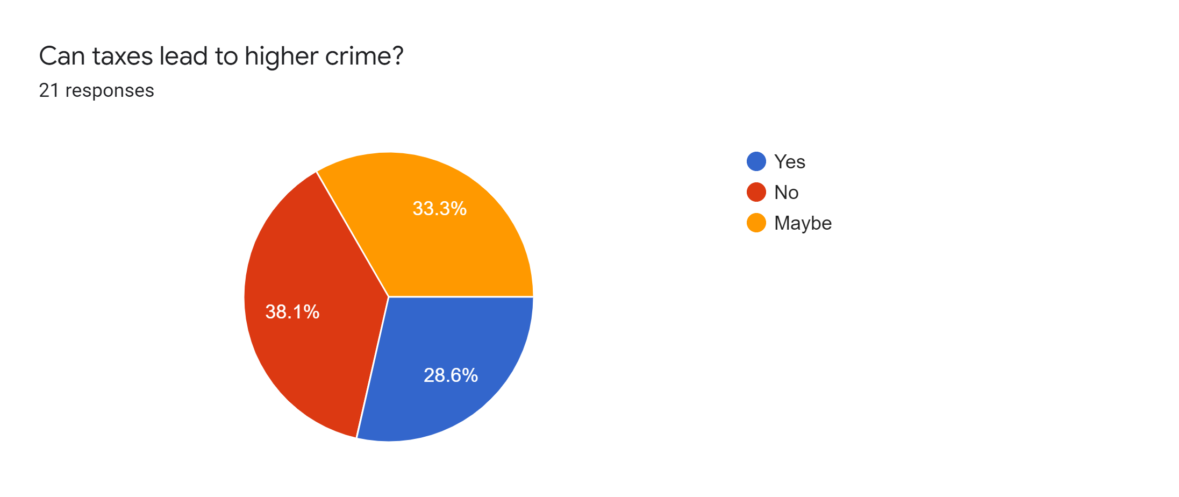
Survey

Slide 25
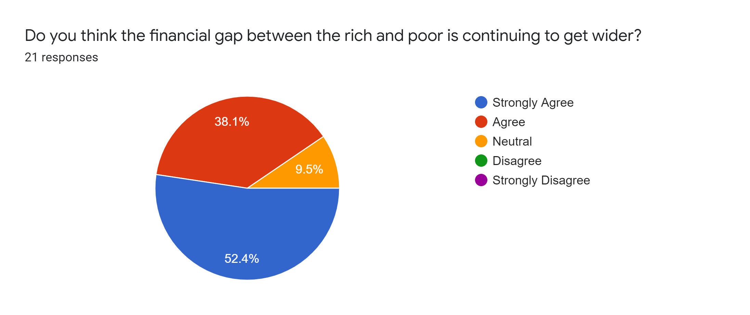

Slide 26
Conclusion
VAT one of the main source of revenue for Government
Taxes act as moderator at times of instability, controls inequality and welfare
GST differs among developed and developing countries to better understand the tax reforms and their impacts more research needed
The existing literature supports the argument that progressive taxation policy has considerable role in reducing income inequalities and boosting overall public welfare.

